Slide 1
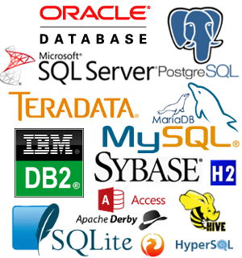


Slide 2
Question-1
How many of you are using database daily??

Slide 3
Why to learn DBMS?
A database management system is an extension of human logic.
Computers can quickly answer lots of questions and some questions can be really complicated
We are easily overwhelmed with information and it is needed to maintain strong relationships between data.
Automation is the key to efficiency
A DBMS is better than manual processes in so many ways and is needed for data access within the company.
Applications – Database integration for applications can add significant functionality to a company’s offerings. This may come in the form of simple information access or providing real-time data to employees and users.
Analytics – Databases are the most common source of information used for various analytics purposes. Companies can store records of financial dealings or performance metrics and gain insights through in-depth analysis.
Organization – Databases are often used to centralize data in a single, dedicated repository that makes retrieving information easy for business users.
You’re interested in making and saving money, aren’t you?

Slide 4
DBMS & DATABASE
A database management system (DBMS) is a collection of programs that manages the database structure and controls access to the data stored in the database.
Efficient data management typically requires the use of a computer database. A database is a shared, integrated computer structure that stores a collection of the following:
• End-user data—that is, raw facts of interest to the end user
• Metadata, or data about data, through which the end-user data is integrated and Managed.

Slide 5
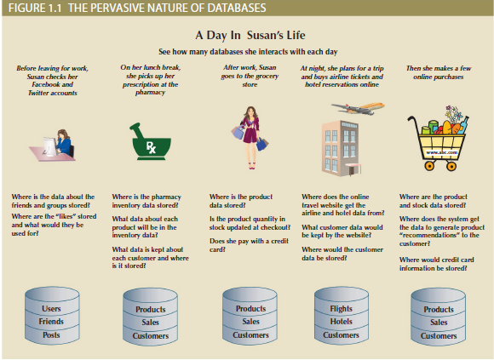
Why Database?

Slide 6
Popular DBMS Software
Here, is the list of some popular DBMS system:
MySQL
Microsoft Access
Oracle
MongoDB
PostgreSQL
dBASE
FoxPro
SQLite
IBM DB2
LibreOffice Base
MariaDB
Microsoft SQL Server etc.
https://db-engines.com/en/ranking

Slide 7
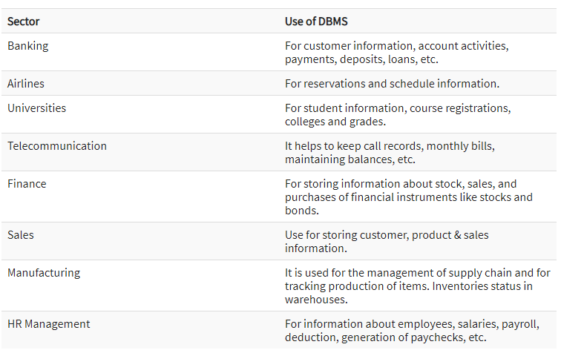
Application of DBMS

Slide 8
Who Uses Database Software?
Data Scientist
Data Analyst
Database Administrator
Database Developer
Database Manager
Database Designer
Database Architect
Database Specialist
Database Engineer
Database Testing

Slide 9
How to choose the right dbms?
Usability of the database management is a critical factor.
Visualization and reporting of data management system is also an important feature.
Security is another important aspect of database management system.
Functionality is another important feature of database management system.
Ensure that system has sufficient support service and development plans.

Slide 10
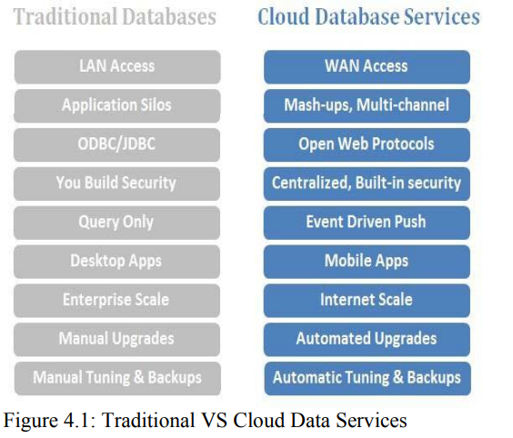
Q.1 Is any relation between database and cloud computing?
Ans:-Yes

Slide 11
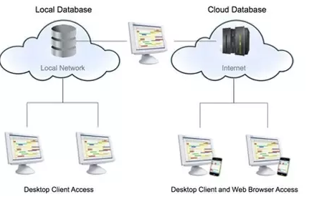
Cloud Database
A cloud database is a database that typically runs on a cloud computing platform, and access to the database is provided as-a-service.
Database services take care of scalability and high availability of the database. Database services make the underlying software-stack transparent to the user.

